Slide 1
Embedded Systems Design Project
Luis Ferreira, Warren Levesque, Sabrina Melo Goncalo, Abdul Mueed

Slide 2
GOAL
The goal of this project was to collectively create a portable gaming device using a DE10 board and an Arduino board
The game is meant to be retro and supposed to display icons on a screen to be selected, matched, removed, and regenerated randomly

Slide 3
RETRO GAMING
The collecting and playing of older generation consoles, computers and handheld games
They are usually based upon older video gaming systems that are obsolete or discontinued

Slide 4
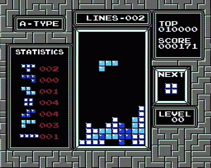
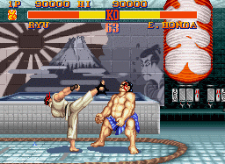
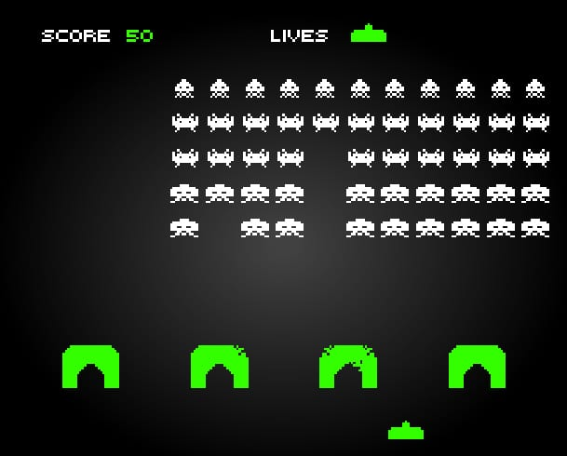
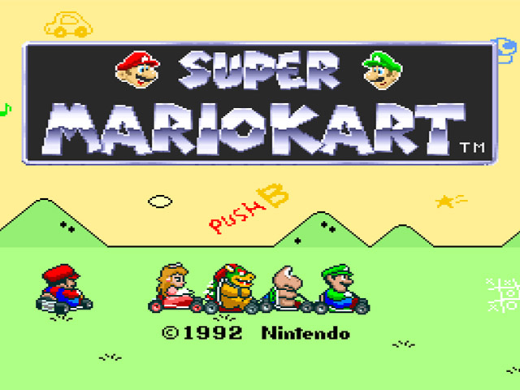
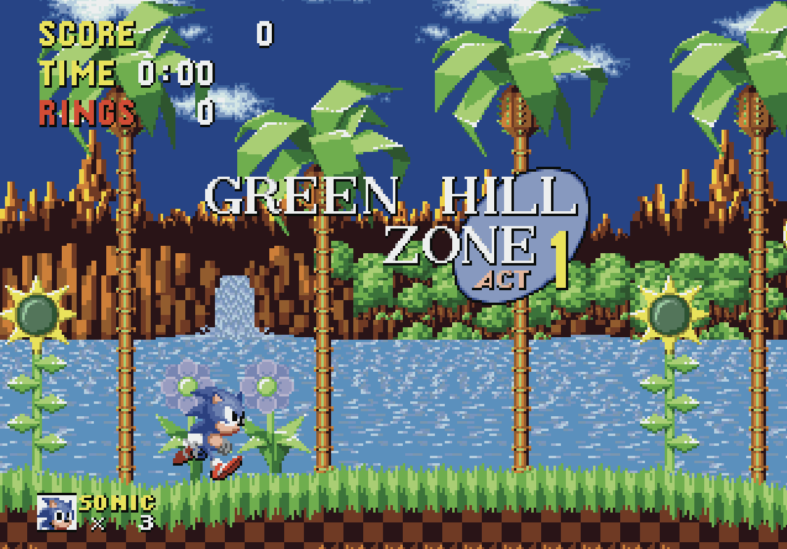
RETRO GAMES
Tetris Street Fighter Space Invaders (Nintendo Gameboy, 1989) (Arcade, 1987) (Arcade, 1978)
Super Mario Kart Sonic The Hedgehog (SNES, 1992) (Sega Mega Drive, 1992)

Slide 5
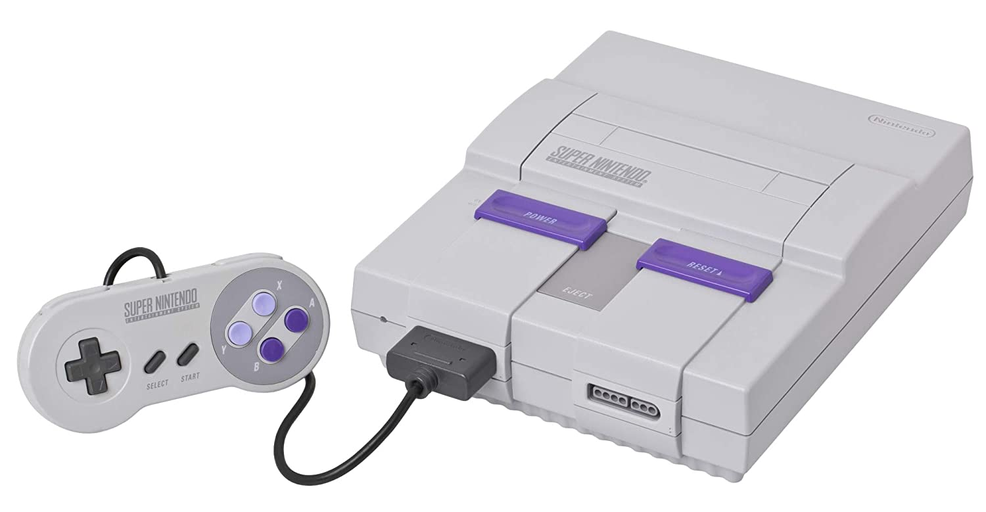
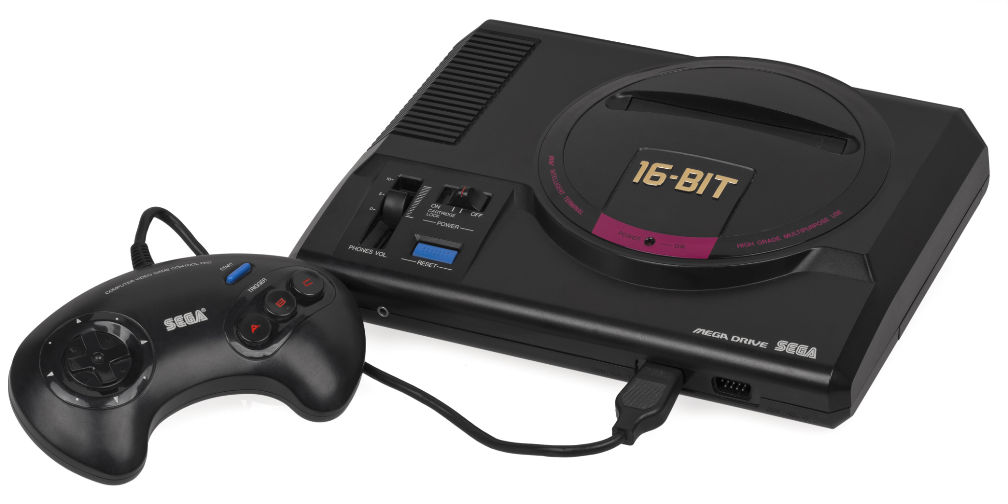
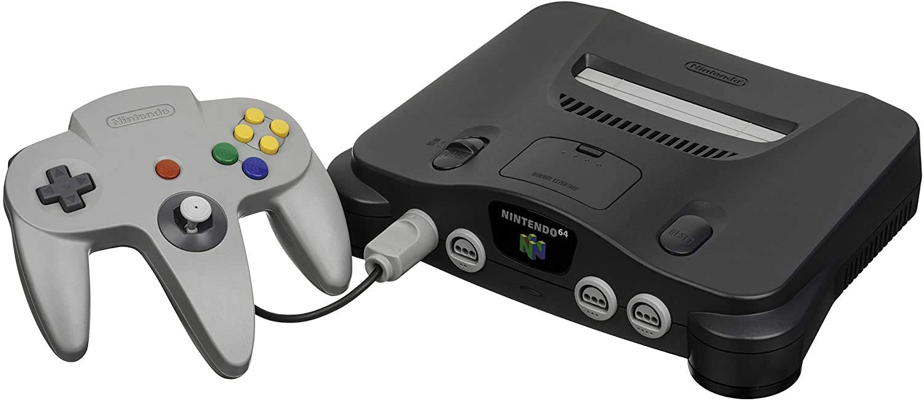
RETRO CONSOLES
SNES Sega Mega Drive Nintendo 64
(1990) (1988) (1996)

Slide 6
PIRACY
The practice of downloading and distributing copyrighted content digitally without permission, such as music or software
Any unauthorized copy is a lost sale, which harms the copyright owner and original creator
Example: Torrenting
Frequently used to share files that are protected by copyright
Can download a file from several other users at once
Can upload a file to multiple users simultaneously

Slide 7
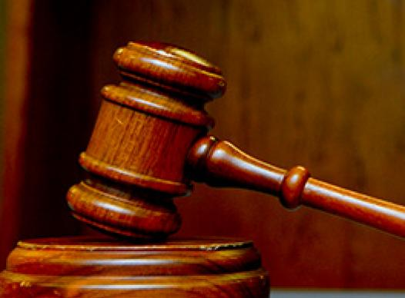
LEGALITY
Retro gaming has been in the market for a very
long time but it is still illegal to pirate it
How was this project done legally? - Inspired by candy crush matching system - Different “console” - Programmed from scratch - Completely designed by the team
member including icons and handheld enclosure

Slide 8
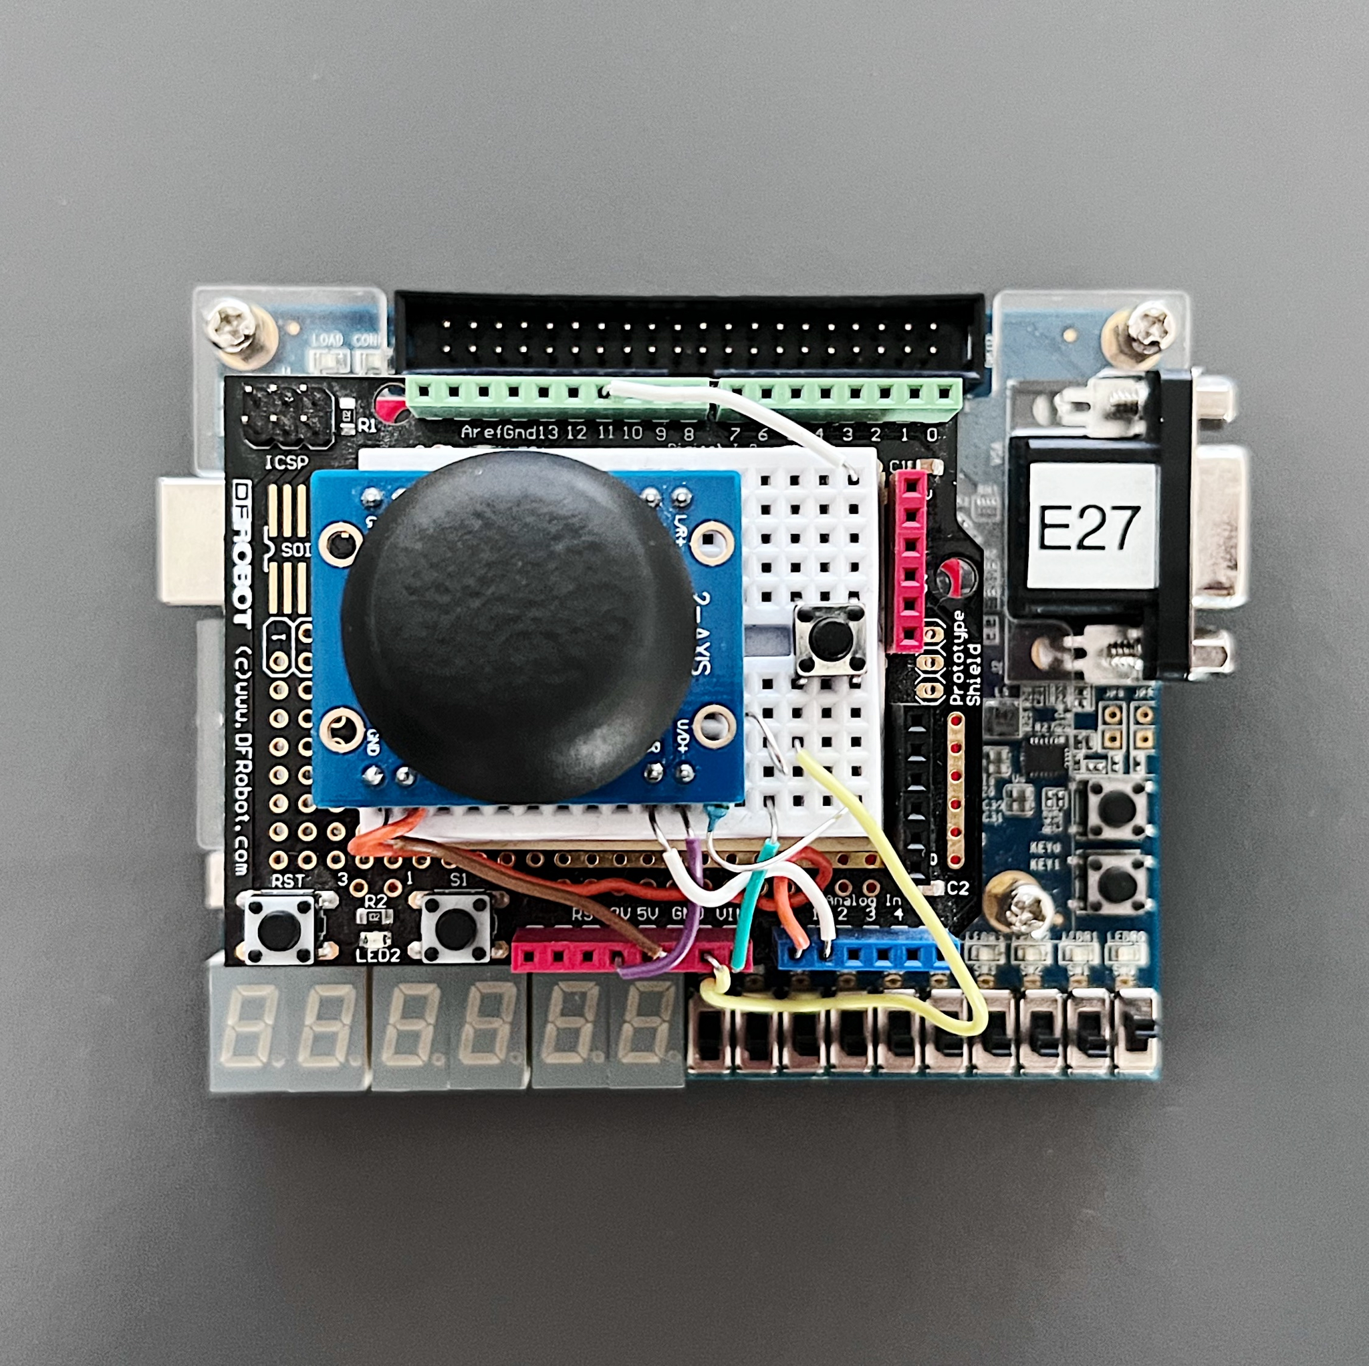
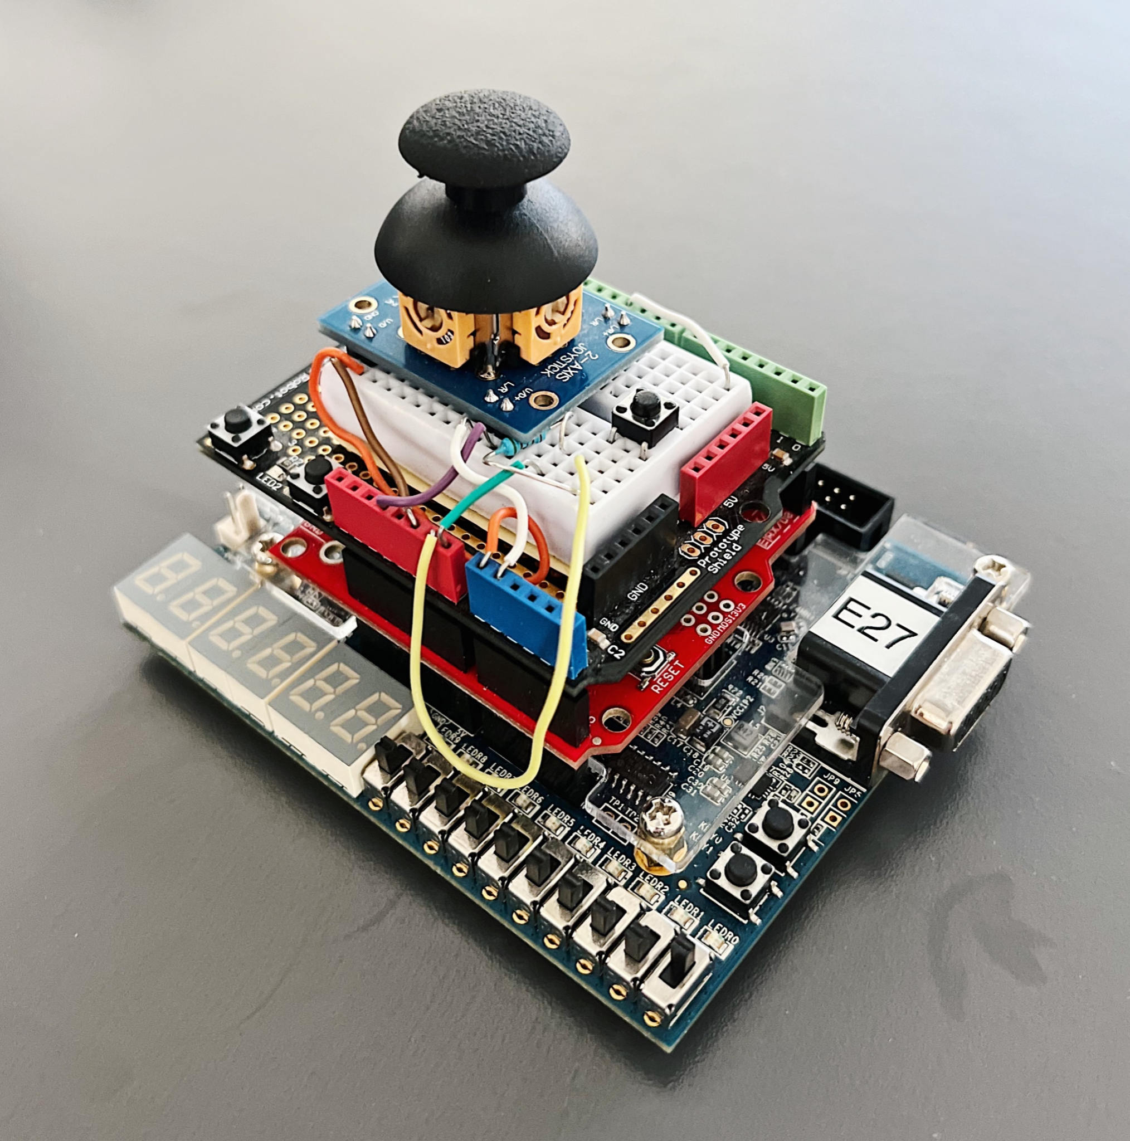
THE SETUP

Slide 9

DESIGN
Photoshop was used to design ten 32x32 pixel icons for a theme of our choosing (Spider-man)
Photoshop was the chosen application due to its diversity
- It allows exporting the file as a bmp
- Has a variety of colors - Allows for drawing individual pixels
- Allows layers to be used

Slide 10






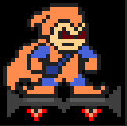


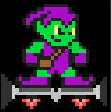
*Not selected*

Slide 11
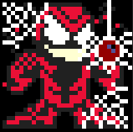
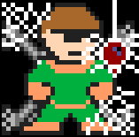
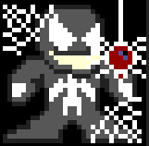
For the selection of the icons, spider webs were added to the corners along with a spider coming down from a web
This was done by adding a layer over the original icons

Slide 12





-Also designed all the letters of the alphabet and numbers (16x24 pixels)
-Designed Spider-man to add to the corners of the screen

Slide 13
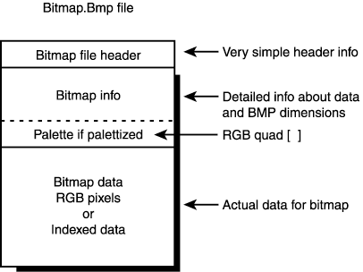
WHY BMP?
BMP also known as the Bitmap File Format is a way to store an image as a series of bits
Easy to read and predictable format
The color values for each pixel are
stored in order

Slide 14
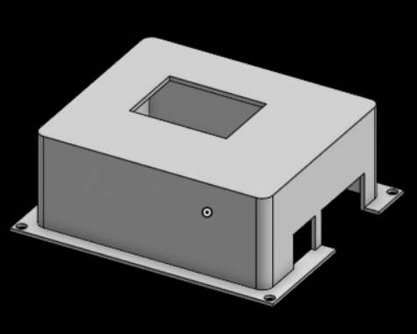
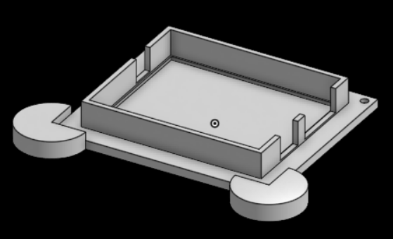
ENCLOSURE
Used OnShape to design the base and the cover of the enclosure to cover the boards and wiring

Slide 15
AUTOMATION
Technology that is concerned with performing a process by means of programmed commands
Human input is minimized
Normally used for - Higher production rates - Increased productivity - Reduced factory lead times

Slide 16
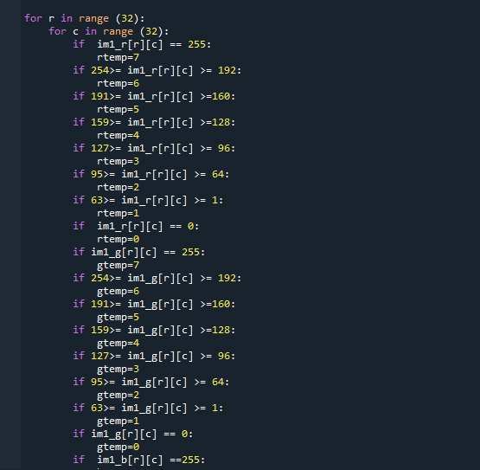
BMP CONVERSION
The BMP file format can not be used as is
A program was made to convert the file from its original format to a useable set of data
Python was used to make this program

Slide 17
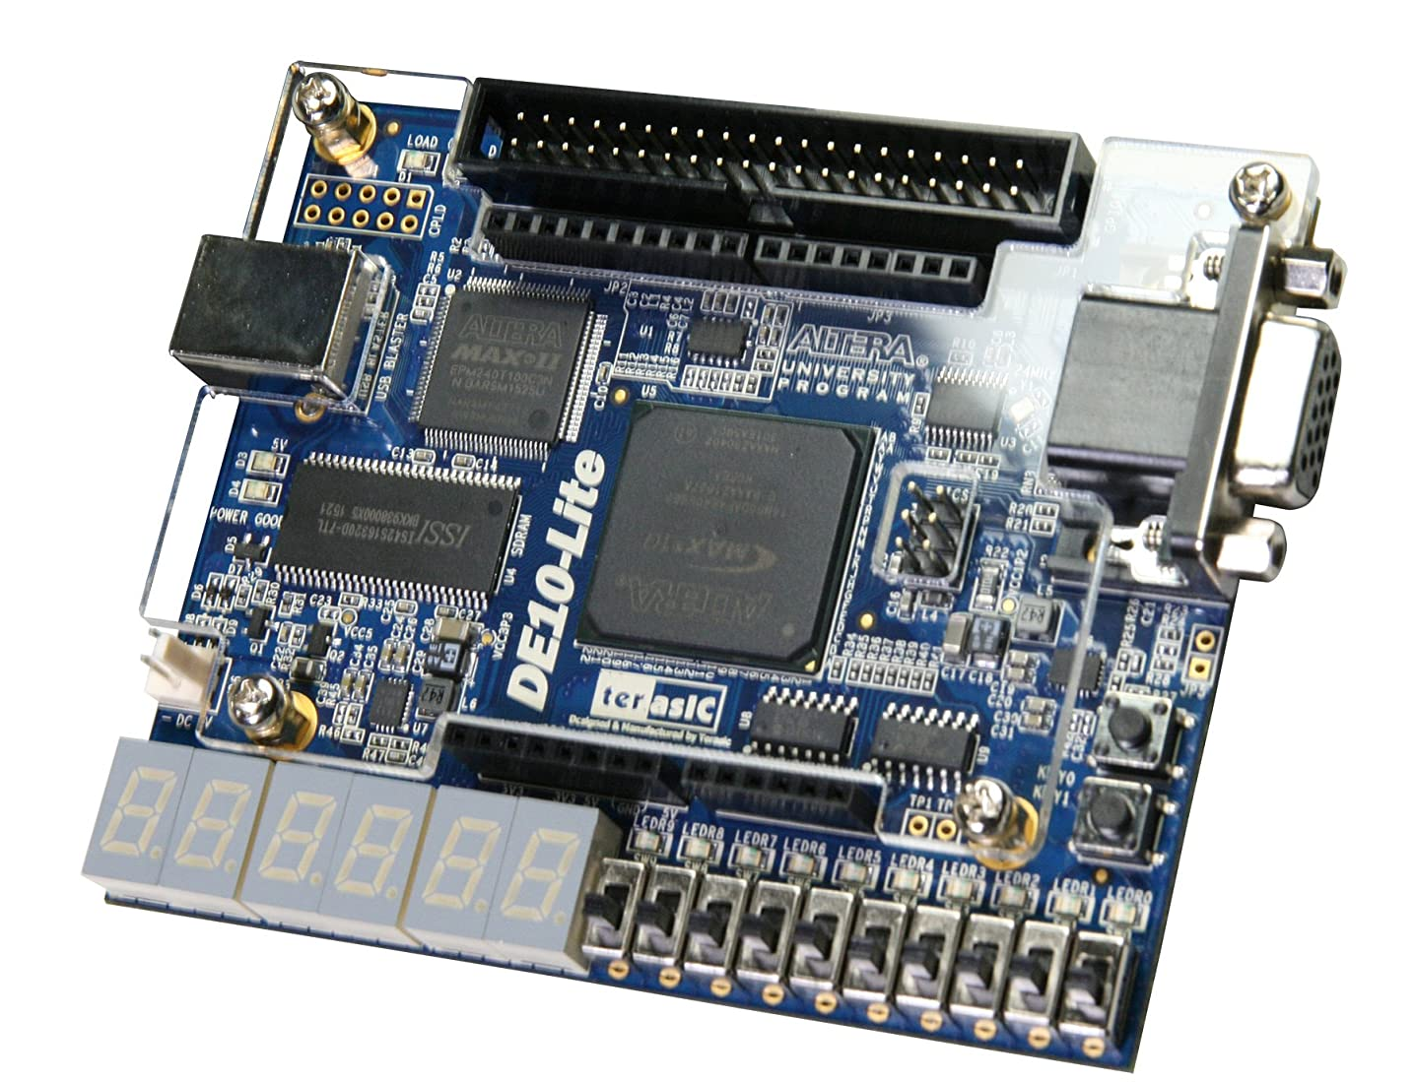
DE10 LITE
The DE10 is a FPGA development board
FPGA - Field-Programmable Gate Array, an integrated circuit that is meant to be further configured by the customer
Developed by Terasic to be a part of the Intel FPGA University Program

Slide 18

ARDUINO
Arduino is an open-source electronic prototyping platform
Open-source: something people can modify and share because its design is publicly accessible
Enables users to create interactive electronic objects
Based on easy-to-use hardware and software
Arduino has more than just one board
Arduino UNO Arduino Mega 2560 Arduino Zero And more

Slide 19
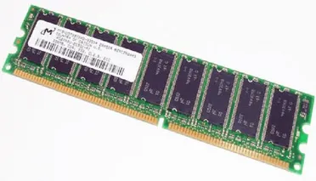
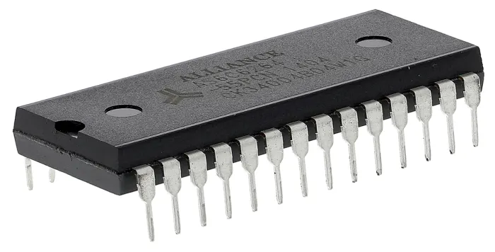
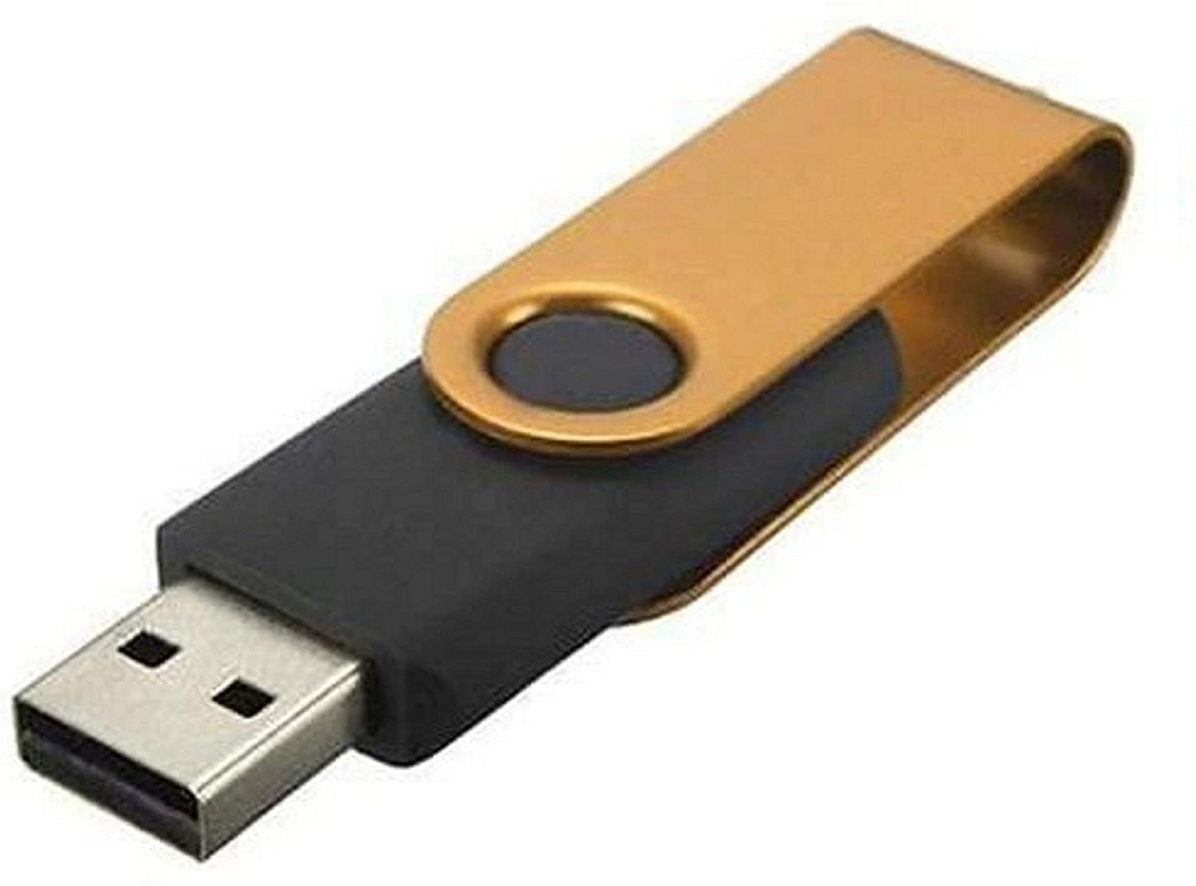
TYPES OF MEMORY
SRAM
SDRAM
Flash Memory
-Static random-access memory
-Low power
-Volatile
-Synchronous dynamic random access memory
-High speed
-Volatile
-Able to be written and rewritten
-Nonvolatile
-Used in Flash Dives, SD Cards, etc

Slide 20
DE10 LITE VS ARDUINO
DE10 LITE Arduino
Advantages: Advantages: - VGA Output - Open Source - Hard Drive Storage - Large Support Network - On Board USB Blaster - Cost Effective ($20) -Quartus Software Functionality - Flash Memory
- Faster Processing
Limitations: Limitations: - Slower Processing - No On-Board Hard Storage - Harder learning curve - No Graphical Output - SRAM Program Storage - Slower Processing - Fairly Expensive ($150)

Slide 21
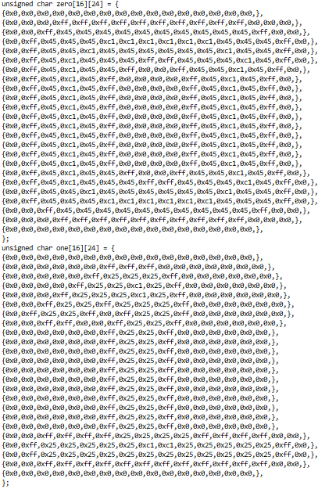
ACCESSING THE BMPs
To access the BMP images stored on the DE10 Lite board a section of automated code needed to be created.
The BMP files are stored sequentially in the hard storage so by finding the start point of each image we can extract the data
This allowed us to access the BMP images fast and efficiently

Slide 22
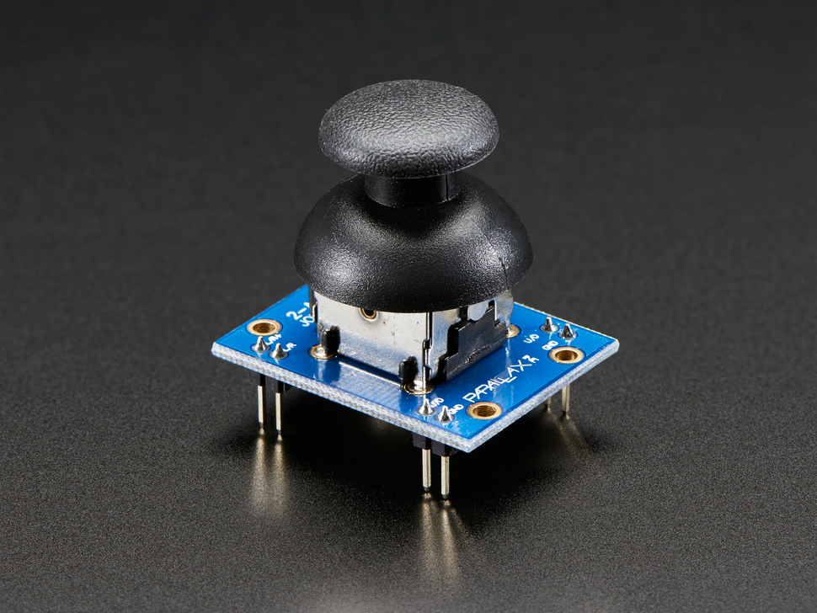
READING THE JOYSTICK
The Joystick is an analog device
Analog devices are defined as electronic systems which have a continuous variable system
ADC - Analog to Digital Converter, an electronic component that converts from an analog to a digital system. This was used to convert analog values from joystick to digital to be read

Slide 23
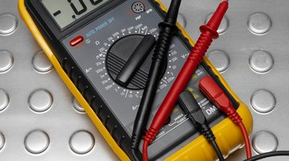
TESTING AND CALIBRATION
We have to read values off the joystick in order to calibrate it in the program
We used a multimeter to read the values
A multimeter is a device used to measure multiple values usually including resistance, voltage, and current

Slide 24
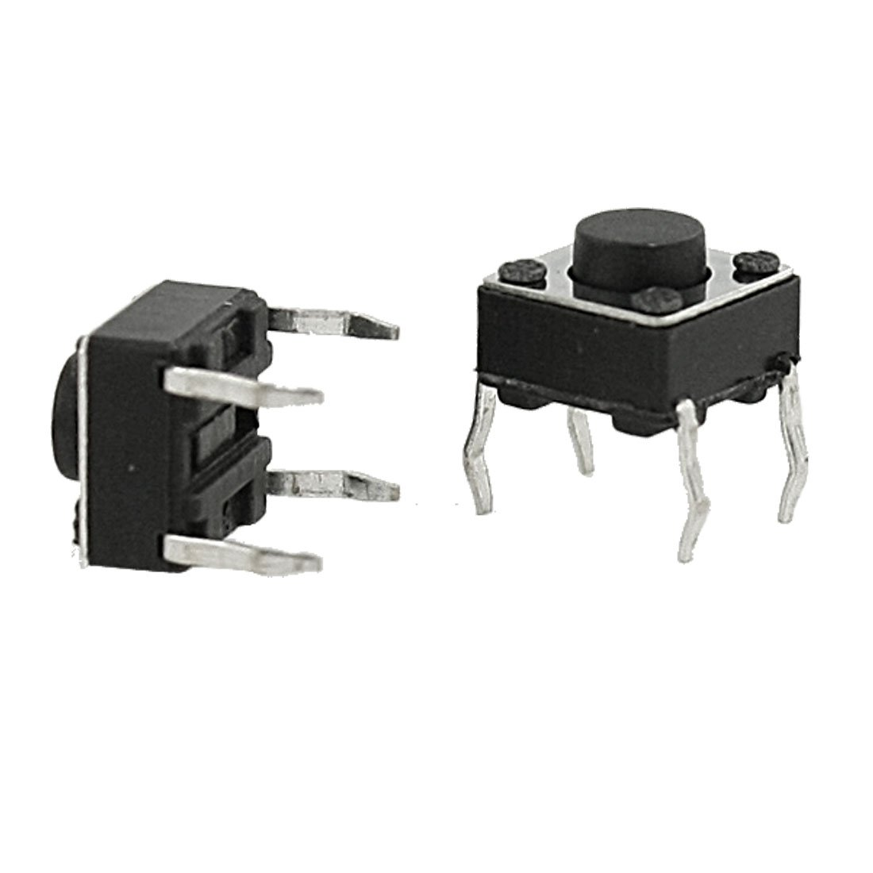
READING THE BUTTON
The button is a digital device
Digital devices are defined as electronic systems which have two possible outputs
ADC is not needed because the processor can already understand the values

Slide 25
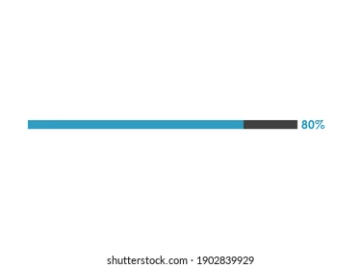
CURRENT COMPLETION
Completed: - Score and Round numbers increase accordingly - Clearing works correctly for full matches that have been selected - Selecting and deselecting works
Bugs: - If only part of a match is selected, after the round is cleared the icons do not reset back to the original unselected form - Joystick needs further calibration for better functionality

Slide 26

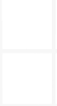
THANK YOU
Any questions?

